Slide 1
Data Pre-processing
Descriptive Data Summarisation

Slide 2
Learning Outcomes
Why pre-processing the data?
Different pre-processing tasks
Descriptive data summarisation
  Central Tendency
  Data Dispersion

Slide 3
Data Mining Process
Problem
definition
_x0004_Data gathering
& preparation
Data access
Data sampling
Data transformation
_x0004_Model building
& evaluation
Create model
Test model
Evaluate model
Interpret model
Knowledge
deployment
Apply model
Custom reports
External applications

Slide 4
Why Data Pre-processing?
Data in the real world is dirty
  incomplete: lacking attribute values, lacking certain attributes of interest, or containing only aggregate data
  noisy: containing errors or outliers
  inconsistent: containing discrepancies in codes or names
No quality data, no quality mining results!
  Quality decisions must be based on quality data
  Data warehouse needs consistent integration of quality data
Notes:
Outlier: is a data point that is located far from the rest of the data. Given a mean and standard deviation, a statistical distribution expects data points to fall within a specific range. Those that do not are called outliers and should be investigated

Slide 5
Data Quality
Perfect data
  Data is valid, complete, and reliable. No data extrapolation is needed
Not Perfect data
  Data with NO serious flaws, but needs some pre-processing
Verbal/Inspection data
  Data with serious gaps → requires additional documentation and verification prior to its inclusion in the DM process
Soft data
  Data relied on the memories of experienced personnel of the participating facility
  The most difficult to summarise
Notes:
Perfect Data: Data needed for a valid, complete reliability study, including a parts list, failure history data with time-to-failure statistics, parts description data, operational periods, and ten continuous years of recorded data. No engineering judgment or data extrapolation is required. The PREPIS equipment record database is comprised of 20% of this type of data.
Not Perfect Data: Data with no serious flaws, but the data collection process demanded additional time to ensure useful information was gathered. Examples include parts list determined by inspection, incomplete blueprints or less than ten years of data. The PREPIS equipment record database contains 40% of this type of data.
Verbal/Inspection Data: Data with serious gaps that required additional documentation and verification prior to its inclusion in the database. Items included were typically major items, such as generator sets and boilers. Senior maintenance personnel were interviewed to extract the necessary information to fill the data gaps. These interviews were used as support documentation to recorded data, not as data source information. About 25% of this type of data exists in the PREPIS equipment record database.
Soft Data: Data that relied on the memories of experienced maintenance personnel from the participating facility; it was often extracted from log books containing maintenance personnel entries, filing cabinets with work order forms, and repair records when outside repair support was needed. Engineering judgment was often used to determine numerous performance parameters. This type of data was the most difficult and time consuming to summarize and was only used when no other data sources were available. The PREPIS equipment record database is comprised of 15% of this type of data.

Slide 6
Examples
Not Perfect data
  The data recorded in a dimension which is not important
Verbal/Inspection data
  Wrong or non-recorded values of an airplane flight parameters
Soft data
  Memories of an experienced analyst who dealt with the same problem before

Slide 7
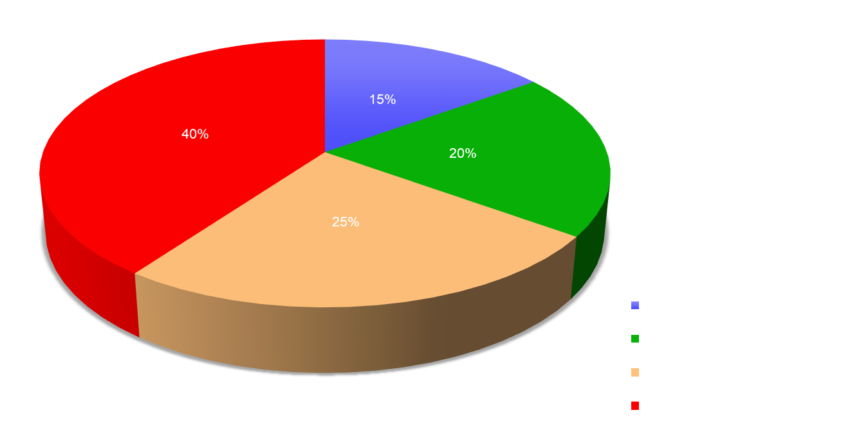
Data Quality

Slide 8
Analysis Plan
Purpose of the analysis
  Identify population groups and domains of interests
  Example
    Population groups: customers, personnel, etc.
    Domain of interest: sales, profit, stock, products, etc.
Audience for the analysis
  Agencies, companies, directors, communities, etc.
Data availability and data quality
  Choices about which data to include
  Etc.

Slide 9
Major Tasks in Data Pre-processing
Data cleaning
  Fill in missing values, smooth noisy data, identify or remove outliers, and resolve inconsistencies
Data integration
  Integration of multiple databases, data cubes, or files
Data transformation
  Normalisation and aggregation
Data reduction
  Obtains reduced representation in volume but produces the same or similar analytical results
Data discretisation
  Part of data reduction but with particular importance, especially for numerical data
Notes:
Discretization is the process of putting values into buckets so that there are a limited number of possible states. The buckets themselves are treated as ordered and discrete values.

Slide 10

Forms of data pre-processing

Slide 11
Learning Outcomes
Why pre-processing the data?
Different pre-processing tasks
Descriptive data summarisation
  Central Tendency
  Data Dispersion

Slide 12
Data Summarisation
Descriptive Data Summarisation
  Identify typical properties of the data
  Highlight which data values should be treated as noise or outliers
Descriptive Statistics
  Understand the distribution of the data
  Central Tendency(measure of center): mean, median, midrange
  Data Dispersion: quartiles, inter-quartile range (IQR), variance

Slide 13
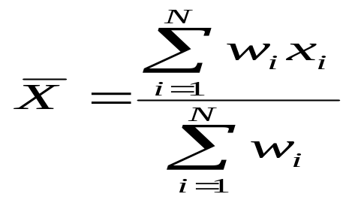
Central Tendency
Arithmetic Mean
  Effective numerical measure of the centre
  Let x₁, x₂, …, x_{N} a set of observations
Drawbacks
  Sensitivity to extreme values (outliers)
  Trimmed mean: obtained after removing the extremes

Slide 14
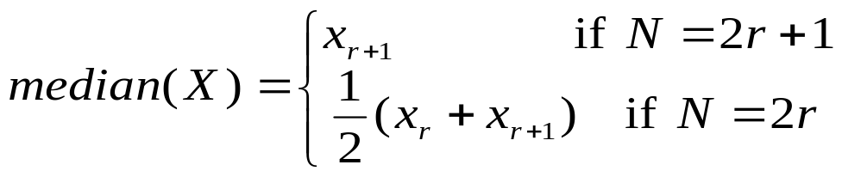
Central Tendency (2)
Median
  Used for skewed (asymmetric data)
  Let {x₁, x₂, …, x_{N}} a set of ordered observations
  The median is the middle value if N is odd and is the average of the two middle values if N is even
  Example: consider the set of values (1, 2, 3, 4, 5, 90}. Calculate the mean and the median
    The mean: 17.5
    The trimmed mean with p=40% is: 3.5
    The median: 3.5

Slide 15
Central Tendency (3)
Mode
  Indicates the value that occurs most frequently in the set
  Example: {140 (0.33), 160 (0.27), 130 (0.22), 170 (0.18)
    The mode is: 140
Midrange
  Range(X) = max(X) - min(X)
  Midrange(X) = [max(X) + min(X)]/2

Slide 16
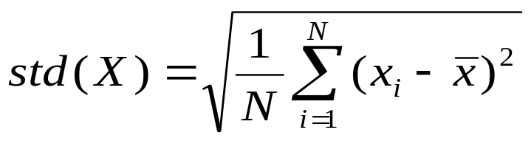
Data Dispersion
Dispersion of the Data
  The degree to which numerical data tend to spread
  The most common measures are
    Range
    Five-number summary
    Inter-quartile range
    Standard deviation
Standard Deviation
  Measures spread about the mean
  Can only be used when the mean is chosen as the measure of the centre
  Let X={x₁, x₂, …, x_{N}}

Slide 17
Data Dispersion (2)
Percentiles
  Let X be a set of ordered observations
  k^{th} percentile of X is x_{i} such that k% of X is below x_{i}
Quartile = 25th percentile
  1st quartile (Q₁), 2nd quartile (Q₂), 3rd quartile (Q₃)
  Inter-quartile range (IQR): IQR = Q₃ - Q₁
Five-number summary
  Includes information about end-points
  = {min(X), Q₁, median, Q₃, max(X)}

Slide 18
Examples: Q1 & Q3
Let X = {70, 65, 54, 56, 57, 80, 71, 46, 55, 63, 62, 53, 68, 76, 58, 54}.
Calculate Q1 and Q3
Sorting X.
{46、53、54、54、55、56、57、58、62、63、65、68、70、71、76、80}
Calculate positions
Q1 position: 16×25％＝4，
Q3 position: 16×(100－25)％＝12
Find the values by the positions
(The average of the 4th and 5th values, n=16)
Q1 ＝(54＋55)÷2 ＝54.5
Q3=?
Notes:
Q3 = (68+70)/2 = 69

Slide 19
Examples of Quartiles
N | values | Median | Q1 | Q3
13 | 1, 2, 3, 4, 5, 6, 7, 8, 9, 10, 11, 12, 13
14 | 1, 2, 3, 4, 5, 6, 7, 8, 9, 10, 11, 12, 13, 14
15 | 1, 2, 3, 4, 5, 6, 7, 8, 9, 10, 11, 12, 13, 14, 15
16 | 1, 2, 3, 4, 5, 6, 7, 8, 9, 10, 11, 12, 13, 14, 15, 16
7 | 4 | 10
7.5 | 4 | 11
8 | 4 | 12
8.5 | 4.5 | 12.5

Slide 20
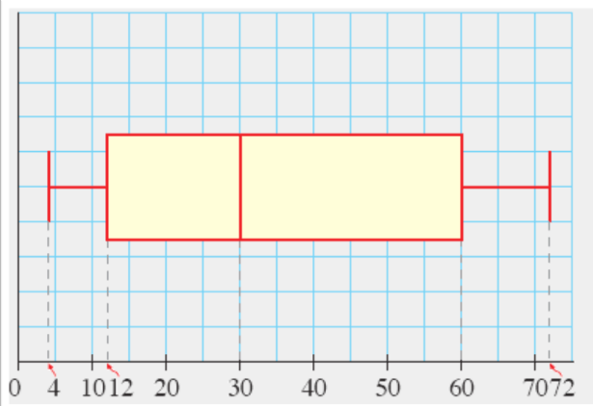
Examples: boxplot
X = {30, 30, 50, 52, 4, 6, 10, 12, 23, 25, 60, 67, 70, 72}
Min
Q1
Q2
Q3
Max

Slide 21
Visualising a Distribution
180
160
140
120
100
Unit Price (€)
80
60
40
20
Branch 1
Branch 2
Branch 3
Branch 4
Boxplot

Slide 22
Visualising a Distribution
Histograms
  Frequency histograms
  A graphical method for summarising the distribution of a given attribute
Quantile plot
  Simple way to have a 1st look at a univariate data distribution
  Allows us to compare different distributions based on their quantiles
Quantile-Quantile Plot (q-q plot)
  Graphs the quantiles of one univariate distribution against the corresponding quantiles of another
  Is a powerful visualisation tool
Scatter Plot
  Each pair of values is treated as a pair of coordinates in an algebraic sense and plotted as points in the plane
  Most effective graphical methods for determining if there appears to be relationship, patterns, or trends between two numerical attributes

Slide 23
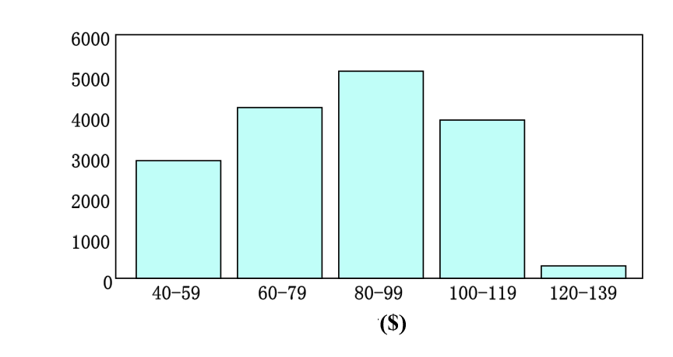

Visualising a Distribution (cont.)
Histograms
Fees
Price

Slide 24
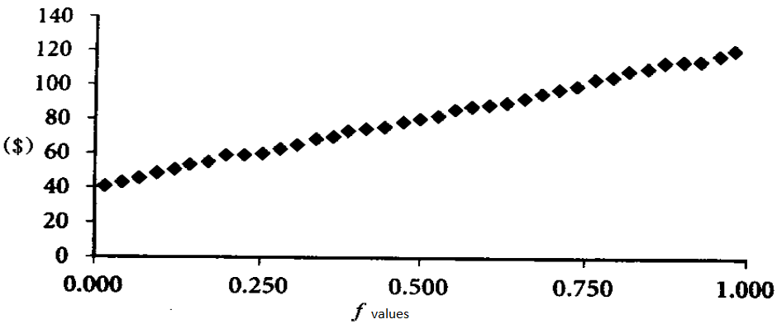
Visualising a Distribution (cont.)
Quantile plot
Fees

Slide 25
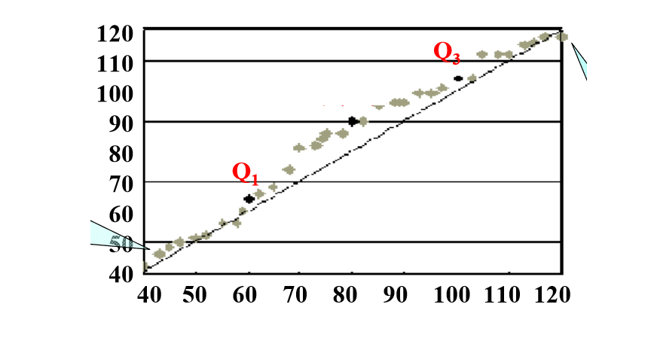
Visualising a Distribution (cont.)
Quantile-Quantile Plot (q-q plot)
Q2
The Price of shop2 is higher
shpop1
The Price of shop2 is lower
shop2

Slide 26
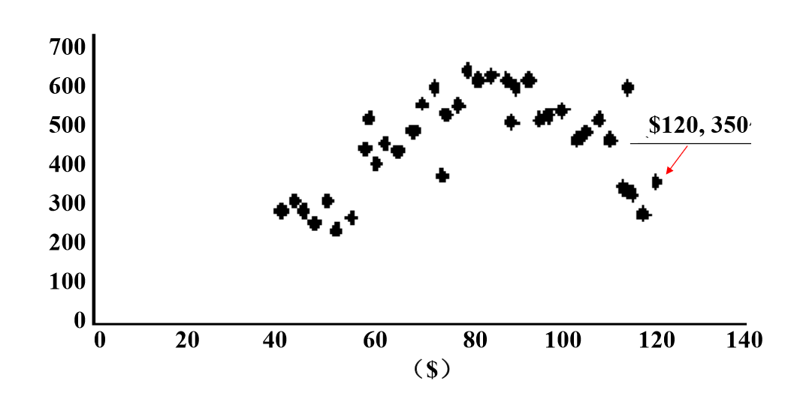
Visualising a Distribution (cont.)
Scatter Plot
Number of prods

Slide 27
Home Work
Suppose a hospital tested the age and body fat data for 18 randomly selected adults with the following results.
  Calculate the mean, median, and standard deviation of age and %fat.
  Draw the boxplots for age and %fat.
  Draw a scatter plot and q-q plot based on these two variables.
  Normalise the two variables based on z-score normalisation.
  Calculate the correlation coefficient (Pearson’s product moment coefficient).
  Are these two variables positively or negatively correlated?
age | 23 | 23 | 27 | 27 | 39 | 41 | 47 | 49 | 50
%fat | 9.5 | 26.5 | 7.8 | 17.8 | 31 | 4 | 25.9 | 27.4 | 31.2
age | 52 | 54 | 54 | 56 | 57 | 58 | 58 | 60 | 61
%fat | 34.6 | 42.5 | 28.8 | 33.4 | 30.2 | 34.1 | 32.9 | 41.2 | 35.7

